Slide 1
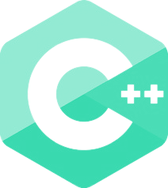
#1 INTRODUCTION TO C++
Daniel Emeka - Ilozor

Slide 2
TABLE OF CONTENTS
01
02
04
03
Overview
C++ Tech
Q/A
Why learn C++?

Slide 3
01
OVERVIEW

Slide 4

INTRODUCTION
Welcome to the C++ Journey!
In this course, you will embark on a rewarding journey of mastering the C++ programming language. Our comprehensive curriculum is divided into three parts: Beginner, Intermediate, and Advanced. Each part will equip you with essential skills, enabling you to build a solid foundation and tackle increasingly complex challenges.

Slide 5

INTRODUCTION
BEGINNER
In the Beginner section, we'll introduce you to the world of programming and dive into the fundamentals of C++. You'll learn about program structure, data types, conditional statements, loops, functions, and more. By the end of this part, you'll be ready to create basic C++ programs. This is not enough to become a C++ expert just yet…

Slide 6
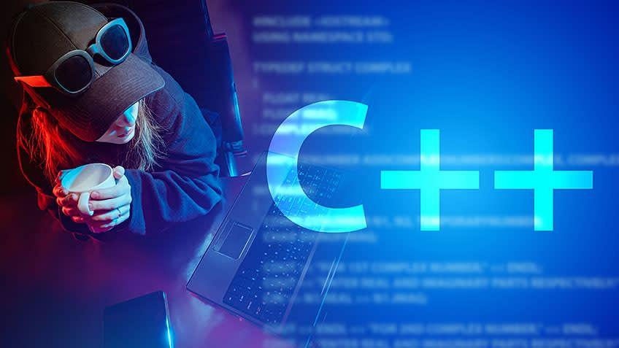
INTRODUCTION
INTERMEDIATE
In the Intermediate section, we'll delve deeper into C++ with a focus on more advanced concepts. You'll gain expertise in recursion, work with structs and pointers, understand C++ STL data structures and algorithms, and learn file handling and exception handling. This part will empower you to handle more sophisticated projects and solve complex problems with confidence.

Slide 7

INTRODUCTION
ADVANCED
In the Advanced section, you'll master Object-Oriented Programming (OOP) in C++. We'll cover operator overloading, inheritance, polymorphism, friends, templates and many more. By understanding these advanced concepts, you'll be prepared to design scalable and maintainable C++ applications and dive into various areas including multithreading, artificial intelligence, and game development.

Slide 8
INTRODUCTION
Your Path Forward
Throughout the course, we encourage you to engage actively, ask questions, and participate in the final(and mini) projects to apply your newfound skills creatively. After completing this journey, you'll be well-prepared to pursue various paths, whether it's acing coding interviews, developing exciting applications, creating immersive games, or exploring the depths of data structures and algorithms.
Happy Coding!

Slide 9
HOW TO BENEFIT FROM THIS COURSE
Consistency
Practice
Help
Experiment
Practice regularly by working on personal coding mini-projects
Stay consistent and dedicated to learning
Engage in discussions and seek help from online communities when stuck
Experiment with C++ outside classes!

Slide 10
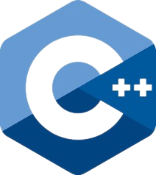
C++
C++ is a powerful and versatile programming language.
Developed by Bjarne Stroustrup as an extension of the C language.
It combines high-level and low-level programming features, making it efficient, versatile, and suitable for various applications.
Widely used in various domains, including software development, game development, system programming, and more.

Slide 11
02
WHY LEARN C++?

Slide 12
Versatility
WHY LEARN C++?
C++ is a versatile programming language suitable for various applications,
including desktop, system-level, and
high-performance software development
for computers, mobile devices, and embedded systems.

Slide 13
—Erik Naggum
“Life is too long to know C++ well”

Slide 14
Performance
WHY LEARN C++?
C++ excels in performance with low-level memory control and direct hardware access, enabling efficient code execution and resource usage. It's a top choice for performance-critical applications like real-time systems and games.

Slide 15
Industry Demand
WHY LEARN C++?
C++ is widely used by leading companies for critical applications, creating a high demand for C++ experts in the job market. Mastering C++ opens doors to various career opportunities in software development, game development, embedded systems, and beyond.

Slide 16
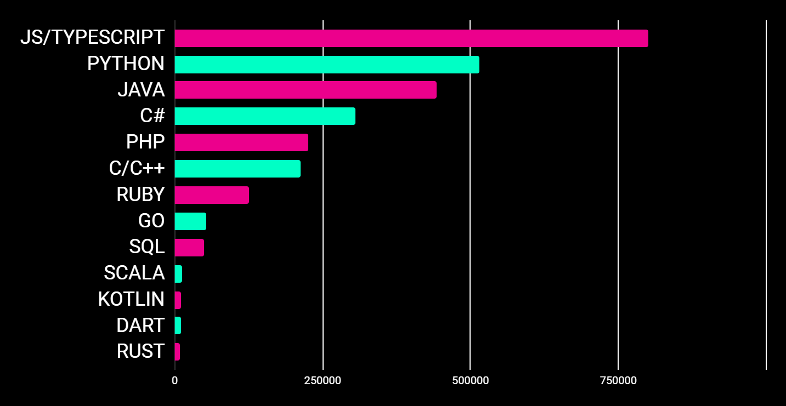
Most Demanded Programming Languages by Number of Jobs
Number of Jobs

Slide 17




Compatibility
WHY LEARN C++?
C++ is backward compatible with C, enabling seamless integration of C code into C++ programs. This allows you to use existing C libraries in C++ projects, saving time and effort.
Learning C++ also makes it quite easy to learn many other programming languages.

Slide 18

Open Source Libraries
WHY LEARN C++?
C++ offers a diverse range of open-source libraries and frameworks for various purposes, providing ready-made solutions for common tasks and enabling faster development. Utilizing these resources, developers save time and can focus on building unique features.

Slide 19


Game Development
WHY LEARN C++?
C++ is favored in game development for its high performance. Major game engines like Unreal Engine and Unity are built using C++. Learning C++ enables you to create your games and contribute to existing game development projects.

Slide 20






Competitive Programming
WHY LEARN C++?
C++ is a top choice for competitive programmers on platforms like Codeforces, AtCoder, CodeChef, Leetcode, etc. Its fast execution and comprehensive standard template library (STL) give an edge in efficiently solving complex problems.
Its speed makes it a staple in various competitions, including IOI, ICPC,
and Meta HackerCup.

Slide 21
03
C++ Technologies

Slide 22



Some Technologies in C++
Robotics and Automation
Quantum Computing
Artificial Intelligence
C++ enables AI and machine learning implementations, driving innovations in self-driving cars, medical diagnosis, and beyond.
C++ is used in the design and creation of machines capable of performing tasks autonomously or semi-autonomously.
Although still in its infancy, quantum computing holds tremendous potential to solve complex problems that classical computers can’t handle efficiently.

Slide 23



Some Technologies in C++
Augmented and Virtual Reality
Blockchain Technology
Internet of Things (IoT)
IoT enables device interconnection, fostering smart homes, smart cities and innovative applications across industries
AR and VR applications include gaming, education, training, healthcare, and industrial simulations, enriching user experiences and immersion.
Blockchain technology disrupts industries with decentralization and security, used in cryptocurrencies, supply chain management, smart contracts, and beyond.

Slide 24
THANKS!
Q/A
Please, keep this slide for attribution.

